Slide 1


Academic Writing at Masters Level
MSc Advanced Paramedic Practice
Learning Development Centre
Kim Williams
Academic Development Tutor

Slide 2
Your assignment…
Coursework of 2000 words in an essay based on a selected case study. This coursework will allow students to evaluate the anatomical and pathophysiological knowledge used to underpin safe and effective assessment and diagnosis, synthesis and critical evaluation of evidence to support the management of the selected case study, including any appropriate onward referral or safety netting.

Slide 3
What your marker is looking for…
Task
Select one Case Study to focus on for the purposes of this coursework.
Identify and critically evaluate the anatomical and pathophysiological knowledge required to underpin safe and effective assessment and diagnosis. (LO 1)
Synthesise and critically evaluate the evidence to support management in the context of advanced paramedic practice and primary care, including appropriate onward referral or safety netting. (LO 4)

Slide 4
One of the biggest barriers…
“I can’t write ‘academically’
“I’m not academic”
FEAR
Academic writing is simply a learned skill
It has rules and regulations – just like driving a car!

Slide 5
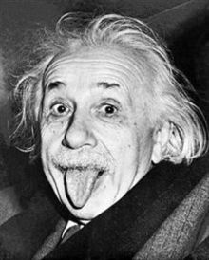
Keep your mind-set positive…
“It's not that I'm so smart, it's just that I stay with problems longer"

Slide 6

Discuss…
What are your concerns about academic writing at Masters level?

Slide 7
Overall Learning Objective
By the end of today’s session we will be able to demonstrate our understanding of:
How to effectively plan for a piece of academic writing
The conventions of academic writing
Next session: Critical writing and Referencing

Slide 8
PLANNING FOR ACADEMIC WRITING

Slide 9
Planning your case study
Interpret the question
Locate the information
Read and take notes
Write a plan
Write the introduction
Write the main body and conclusion
Review & edit

Slide 10
STEP 1: INTERPRET THE QUESTION
Coursework of 2000 words in an essay based on a selected case study. This coursework will allow students to evaluate the anatomical and pathophysiological knowledge used to underpin safe and effective assessment and diagnosis, synthesis and critical evaluation of evidence to support the management of the selected case study, including any appropriate onward referral or safety netting.
It isn’t really a question! But you can break it down into its component parts and ensure you understand each of these…
  dress patients?
Notes:
So, given what we’ve just been discussing – how would you answer this question?? What is it actually asking you, think about all the different parts to the question.
I’m not looking for you to give me the content here, I just want you to think about what types of questions you would be asking…
Where people fall down with questions like this is that they just describe the causes – they would state, junk food, tv and not going out enough.
However you also have to be critical – you would evaluate each cause, how much impact does it actually have? Are there any statistics or pieces of research to say one is more of a cause than the others? Etc.
Any specific words in the question that give you a clue?

Slide 11
STEP 2: LOCATE INFORMATION
Text books – general overview; journal articles – more specific
Make sure include relevant material from lectures (but do not reference lecture notes)
Use recommended reading list and beyond
Use electronic databases
  dress patients?
Notes:
Ok so where are you going to look for your information? What type of sources will you be using?
Then go through books, journals and websites.
Writing with no reference to course material is a big failing in assignments. Remember though, your lecture notes are only a starting point.
Why should you be careful of google? What about things like NHS24 for any medical information. Wikipedia etc. The thing to note about electronic resources is that you have to be careful – who are they aimed at? If it’s at Joe public then they may not be suitable.
If you can’t find an author then maybe not a good resource.

Slide 12
STEP 3: READ AND TAKE NOTES
Skim to get overall picture of what text is about. Be aware of themes/topics emerging
Note down the themes/topics and allocate a ‘colour’ for each one
Take a highlighter the colour of your first theme and highlight any relevant information in journal articles/books in that colour
Repeat for all themes/colours
Take each highlighted section in turn and compile notes into sections. Look for gaps in knowledge. Write up notes IN YOUR OWN WORDS
  dress patients?
Notes:
Ok – so you’ve figured out what the question is asking you and you’ve located your information - how do you take notes?
The key here is to get away from just copying out of a book word for word.
You want to write it in your own words not just for plagiarism purposes but it’s to make sure you understand what is there. If you can’t put it into your own words it probably means you don’t understand what it is saying and so will have to spend some time figuring out what that is.
So skim over the sections that you think might help you to pick out key points – this stops you reading things you don’t need to.
Take small parts at a time so it’s not overwhelming and then stop.
Ask yourself – what is the author actually trying to say here – what is their argument and does it feel valid to you?
Go back to the sub questions – does it help you answer them?
This part can be the tough part but all the earlier steps will make this much easier and a lot quicker.
Make sure when you write it out you take the page number from where you got it from so you can go back and check if what you have written is right.

Slide 13
STEP 4: WRITE A PLAN
Develop a structure from your notes
Outline of main arguments on topic – you should find they fit into logical sections
Consider order – paragraphs should be logically connected
  dress patients?
Notes:
If you have followed the process outlined in previous slides – this part should be so much easier.
The people who get stuck here maybe haven’t done as much prep but from time to time people still struggle at this point.
The preparation, making up sub questions and doing very focussed reading should make the structure much more obvious to you.
However briefly this is what a structure should look like.

Slide 14

Critically evaluate the components of a hamburger
Introduction
the importance of hamburgers and their components
the aims of this essay
Main Body
Conclusion
Summary of findings
Conclusion I have drawn
Smith (2009) lettuce is…
Jones (2012) found iceberg…
Wilson (2015) rocket lettuce…
Lettuce
Dixon (2012) the baking time..
Scott (2010) sesame seeds…
Smith (2009) the gluten content…
Bun
Beef
A study by McDonald (2014) found Scotch beef…
Sanders (2011) argues that…
Gherkin
Wilson (2015) found the majority of consumers…
Major (2014) argues that gherkins…

Slide 15
STEP 5: WRITE THE INTRODUCTION
Brief background to the topic
State why the topic is important
The assignment aim “This essay will…”

Slide 16
Introduction
Gorham's disease is a very rare skeletal condition of unknown cause. It is characterized by the uncontrolled proliferation of distended, thin-walled vascular or lymphatic channels within bone, which leads to resorption and replacement of bone with angiomas and/or fibrosis (Smith, 2015). The etiology is still very speculative, the prognosis unpredictable, and any effective therapy still unknown (Jones, 2016). This assignment will presents a critical review of the literature and two case reports of suspected Gorham's disease of the bones of the foot.
*References are fictitious and for illustrative purposes only

Slide 17
STEP 6: WRITE A FIRST DRAFT
Maintain momentum – write steadily
Ensure all concepts/theories/definitions are backed up with references
Ensure there is a clear line of argument flowing through your writing (logical)
Notes:
The maintaining momentum bit is key to bring out here. It’s better to write little bits of your essay each day than leave it for a week and then come back to it. If you do that you will spend lots of time trying to figure out where you where and it will take longer to get back into it.
Have you heard anyone say you should write the introduction last?? I would say that you could write the majority of the introduction first but check the detail at the end. We’ll go over this in more detail later.

Slide 18
STEP 7: REVIEW & EDIT
Leave essay for a few days
Review and ask:
  Has it answered the question?
  Have I included references for key ideas?
  Have I used an appropriate writing style
Proof-read – pay attention to detail; don’t throw away marks due to sloppiness
Make sure presented according to guidelines in assessment handbook

Slide 19
THE CONVENTIONS OF ACADEMIC WRITING

Slide 20
Conventions of Academic Writing
1. Impersonal
Avoid ‘I’, ‘we’ or ‘you’
2. Formal
Avoid contractions, colloquialisms or slang
3. Clear and Concise
4. Provide Evidence
back up statements, opinions, approaches taken
Unless asked otherwise
Avoid run on sentences
State precisely what you mean
Abbreviations written in full the first time you use them
Notes:
.

Slide 21
Impersonal tone
Avoid using the first person (‘I’, ‘you’ or ‘we’)
  In this essay I will investigate…
  This essay investigates…
  You could say consent is an important issue because…
  Consent is an important issue because…
  We can assume from the evidence…
  This evidence suggests that…..

Slide 22
Impersonal tone
Neutral/objective –back up your points with evidence not just experience
✗ The most important thing to consider when dealing with a patient with Parkinson’s Disease…...
✓ Neville (2004) and Simpson (2006) found that the a key benefit for dealing with patients with Parkinson’s Disease is …Conversely, however, Jones (2009) and Smith (2013) both argue that the most important consideration is …

Slide 23
Formal Tone
Avoid abbreviations or contractions such as ‘didn’t’ – use ‘did not’.
Spell out any acronyms that you use the first time that you use them e.g. World Health Organisation (WHO)
Avoid colloquialisms/slang– “keeping the patient in the loop”/ “helped him come out of his shell”

Slide 24
Clear and concise
Academic writing is not about making your writing sound unnecessarily ‘fancy’
Take care with spelling and punctuation – watch sentence length!
A new paragraph should be taken for each new topic you cover. The best way to ensure a clear structured approach is to NEVER EVER begin writing without first making a paragraph plan
Title - ‘Cats as Pets’
Para 1 - Introduction
Para 2 – Vet care
Para 3 – Grooming
Para 4 – Food
Para 5 – Exercise
Para 6 - Conclusion

Slide 25
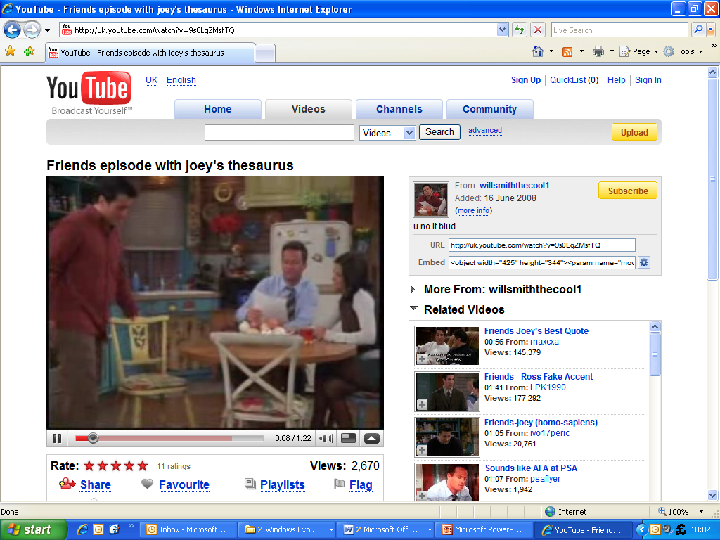
Notes:
http://www.youtube.com/watch?v=9s0LqZMsfTQ&gl=GB&hl=en-GB

Slide 26
For additional support one to one support on academic writing you can:
Book an appointment with an ADT on https://sites.google.com/site/ldcgculearn/
Come along to our ‘drop-in session’ on Wednesdays 2-4pm
Kim Williams
Academic Development Tutor
Learning Development Centre
Govan Mbeki Building – A107

